Slide 1
Yr 10 Week 1
Algebra
Gradient Intercept Form
K. Farmer

Slide 2
Lesson objective
By the end of this lesson you will be able to;
Identify the gradient and y intercept from a linear function.
Sketch a linear graph from a linear expression in the gradient intercept form.
Notes:
Lesson

Slide 3
Success Criteria
You will know you are successful in achieving the objective by…

Slide 4
Carousel Brainstorm Review of Gradient
Break class into 5 groups
Hand out an A3 paper to each group
Have student use textas to great a poster of everything they remember about yesterdays lesson on ‘Gradient” in 4 minutes.
When the timer sounds- students leave their poste, stand and move clockwise to the next table.
Students have 2 minutes to read through and add any new ideas to the poster they now have.
Repeat this process reducing the time to 1.5 minutes per table and possible down to 1 minute for the last few tables.
Discuss the results.

Slide 5
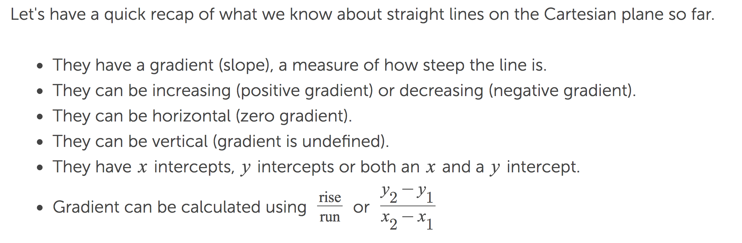
The poster should include at minimum the following information….

Slide 6
Guided Activity
Gradient intercept form foldable.
Make sure this booklet is printed front to back to ensure it folds correctly.
Work through booklet. Solutions can be projected on the IWB.
Glue this in the LHS of INB
Notes:
Independent practice

Slide 7
Lesson Review

Slide 8
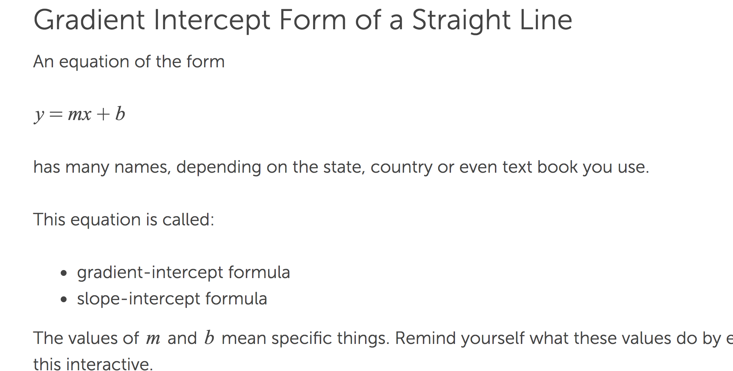
24
7
30
Date
Linear Algebra
EQ – How do I represent a line in the Gradient Intercept form
5
Notes:
Lesson objective (EQ)

Slide 9
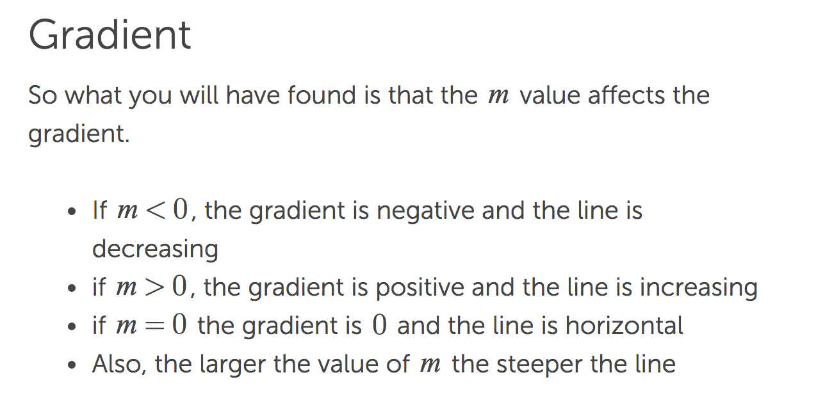
24
7
30
Date
Linear Algebra
EQ – How do I represent a line in the Gradient Intercept form
5
Notes:
Lesson objective (EQ)

Slide 10
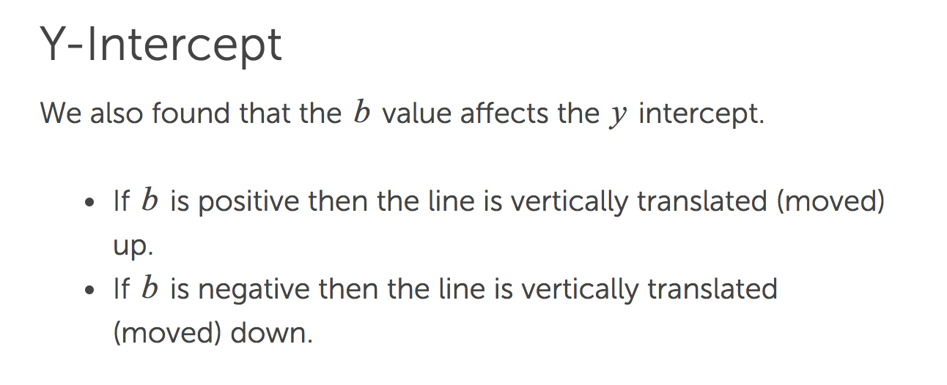
24
7
30
Date
Linear Algebra
EQ – How do I represent a line in the Gradient Intercept form
5
Notes:
Lesson objective (EQ)

Slide 11
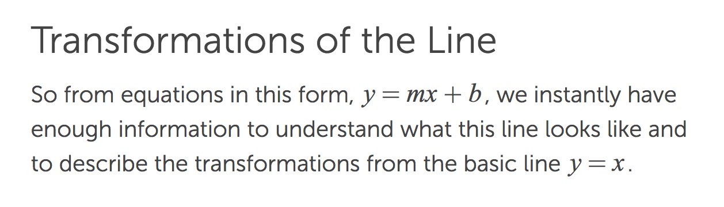
24
7
30
Date
Linear Algebra
EQ – How do I represent a line in the Gradient Intercept form
5
Notes:
Lesson objective (EQ)

Slide 12
Guided Practise

Slide 13
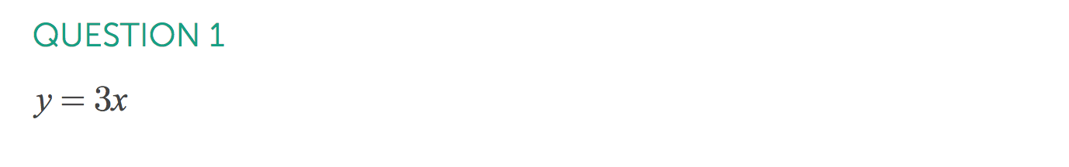
24
7
30
Date
Linear Algebra
EQ – How do I represent a line in the Gradient Intercept form
5
Notes:
Lesson objective (EQ)

Slide 14
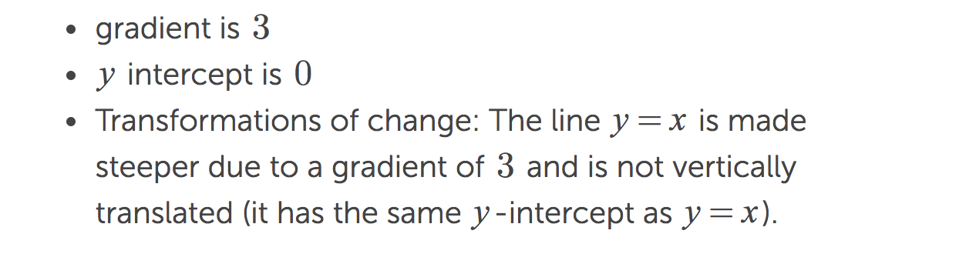
24
7
30
Date
Linear Algebra
EQ – How do I represent a line in the Gradient Intercept form
5
Notes:
Lesson objective (EQ)

Slide 15
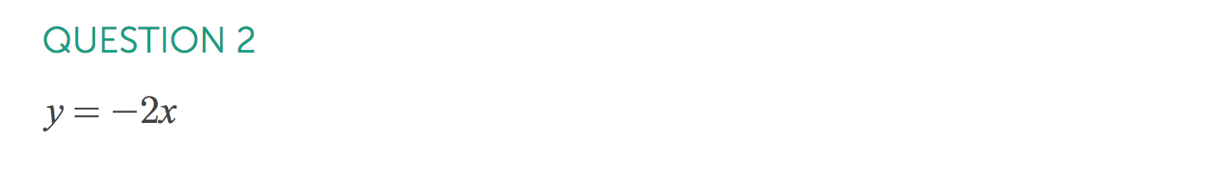
24
7
30
Date
Linear Algebra
EQ – How do I represent a line in the Gradient Intercept form
5
Notes:
Lesson objective (EQ)

Slide 16
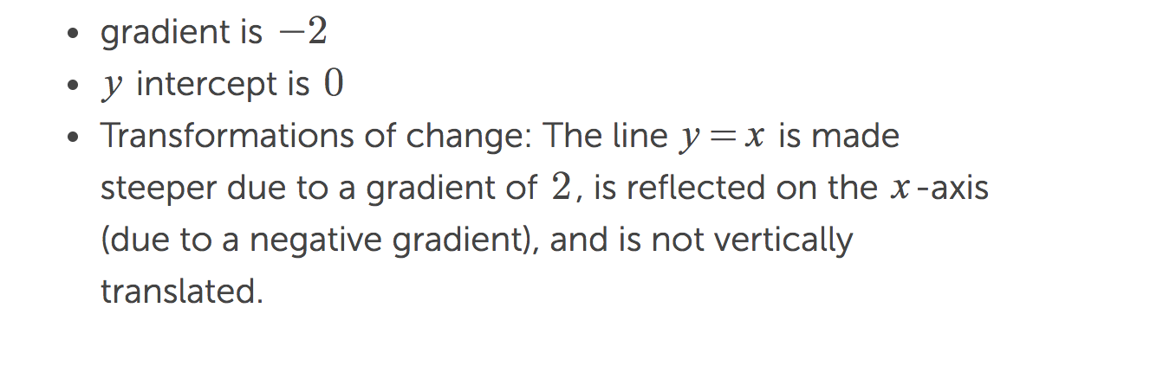
24
7
30
Date
Linear Algebra
EQ – How do I represent a line in the Gradient Intercept form
5
Notes:
Lesson objective (EQ)

Slide 17
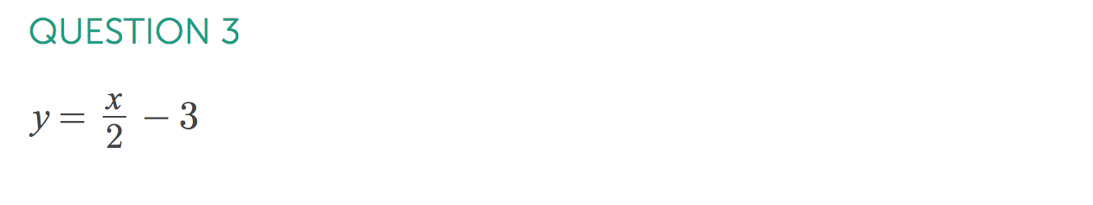
24
7
30
Date
Linear Algebra
EQ – How do I represent a line in the Gradient Intercept form
5
Notes:
Lesson objective (EQ)

Slide 18
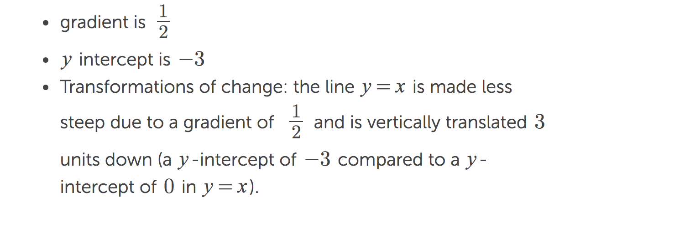
24
7
30
Date
Linear Algebra
EQ – How do I represent a line in the Gradient Intercept form
5
Notes:
Lesson objective (EQ)

Slide 19
Check for understanding
Success On target observation
Notes:
Check for understanding

Slide 20
Closure activity
Quick write
Notes:
Closure

